Slide 1


Team 42: Multi-Axis Cobot for Factory Automation
Bi-Weekly Update 1 Emily Hamsa, Ethan Woods, Adrian Guzman, Jaishil Shah Sponsor: Matthew Krebs TA: Zian Wang
Notes:
Michelle

Slide 2

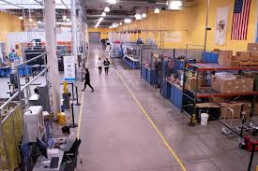
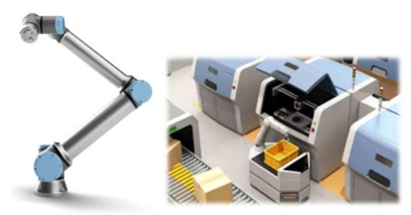
Project Summary
Problem statement:
Factory settings pose dangerous environments to human workers through the exposure to heavy machinery, tight spaces, and repetitive workloads. These hazards increase chance of injury and worker burnout. We need to implement collaborative robots (Cobots) to improve worker conditions.
Human Injury & Burnout in Warehouses
Cobot Solution
Notes:
Adrian

Slide 3
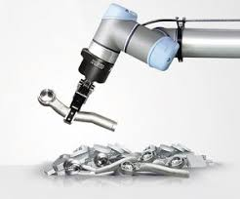
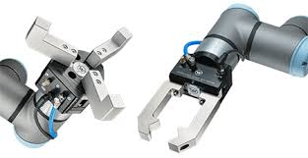
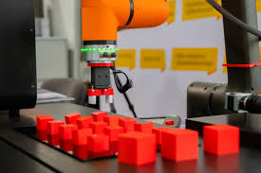
Project Summary
Solution proposal:
Develop a Cobot that can integrate into a factory environment to reduce human injury, worker burnout, and increase productivity in repetitive tasks. The Cobot shall be able to lift (1-2 lbs) and be placed into tight environments and controlled wirelessly through mobile app.
Repetitive Tasks
1-2 lbs. Load
Precise Control
Notes:
Ethan

Slide 4
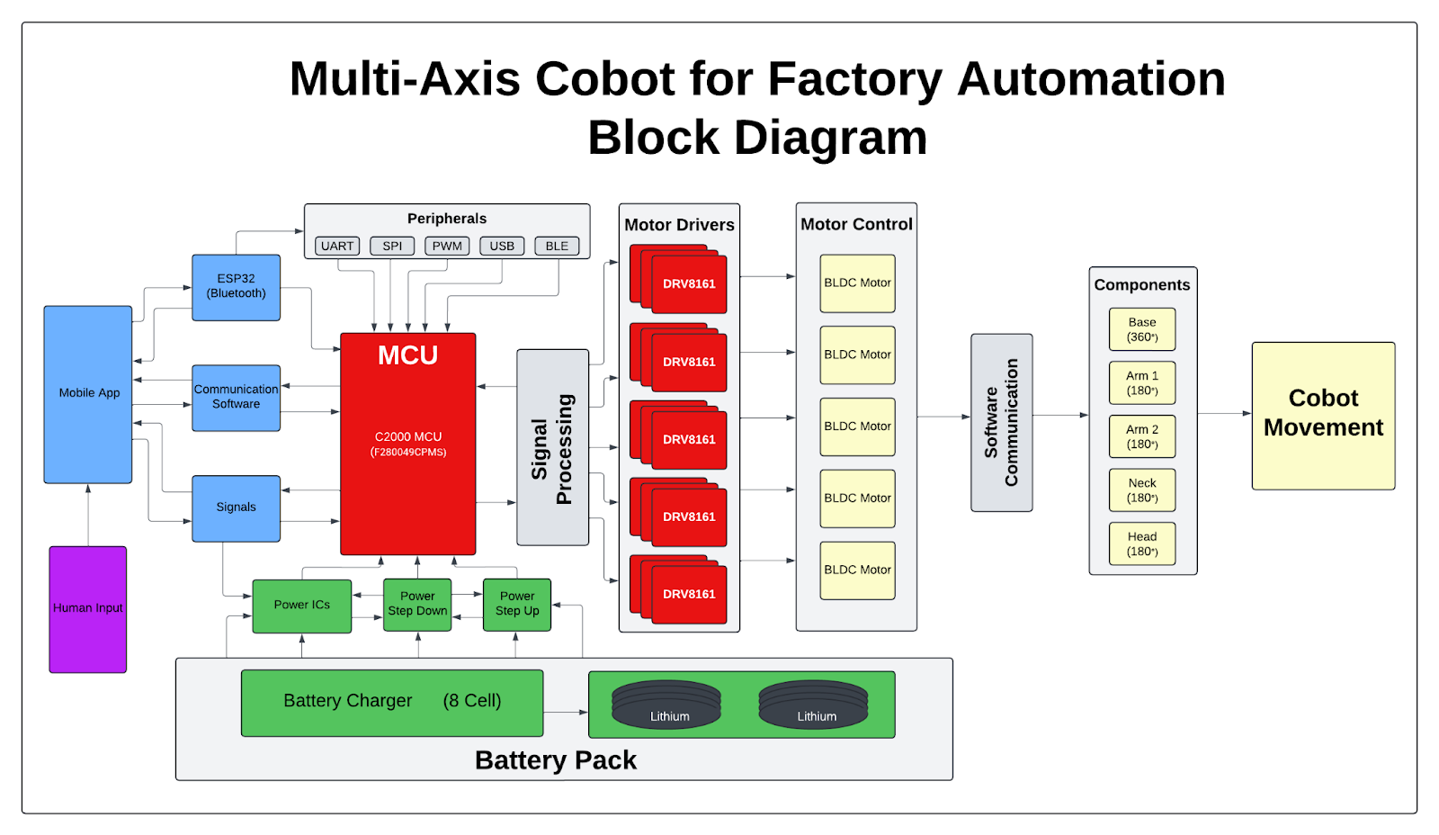
Project/Subsystem Overview
Adrian
Ethan
Jaishil
Emily
Subsystem Diagram Color: Power, MCU/Connectivity, Mobile App, Motor Control

Slide 5
Subsystem Characteristics
Motor Driver: (Ethan Woods)
Motor driver boards to drive 3x phase BLDC motor
Receive signals from MCU to drive/spin the motor
MCU: (Adrian Guzman)
MCU board that will interface between wireless and motor driver
Send required signals to drive the motor drivers
Power: (Emily Hamsa)
Board to step down power from external battery
Effectively provide different voltages and currents subsystems
Wireless: (Jaishil Shah)
Mobile app to interface with user
ESP32 board to communicate with mobile app and C2000 MCU

Slide 6
Major Project Changes for 404
Expected Changes From 403:
New PCB Board for Motor Driver Subsystem
New PCB Board for MCU Subsystem
New PCB Board for Power/Battery Subsystem
App and Controller updates for UI/Wireless Connection Subsystem
Research and Development for the Physical Design of Robotic Arm
Major Project Changes:
Motor reduction from 5 BLDC Motors to 1
Complexity, Budget, Physical Limitations
Loss of Original TI Project Sponsor (Still helping, but not officially at Texas Instruments)
Notes:
Required:Bullets on changes due to team membership changes -- describe how subsystem assignments, roles, project will change to accommodate team changes
Bullets on MAJOR changes in project direction due to learning from 403. If stuff didn’t work out now is the time to redirect
-- eg custom to COTS, MCU changes, application change, major change in communication technology, …
Notes:
New Board for Motor Drivers
New Board for Power Supply
New Board for MCU
App/Wireless Connectivity Updates
Physical Design Work/Implementation
No MAJOR changes, only expected updates
5 BLDC Motors to 1 or 2
Motor Movement through MCU not Launchpads
New Sponsor from TI (not assigned)

Slide 7
Project Timeline
Review/update progress since E403
Team finalizing design of new PCBs
Order PCB and components
Conversation over physical structure of cobot arm…(Amazon purchase with 1x BLDC motor and 3x-4x Servo)
Team is fixing issues with integration between subsystems
Reviewing bugs/fixing problems
Cobot arm should have clear path and deliverables
Team is fully integrated and operational
Cobot arm is moving
Fix issues with accuracy and movement of arm
Update #2 (Feb 3)
Update #4 (Mar 3)
Final #6 (Apr 7)
Update #1 (Jan 15)
Update #3 (Feb 17)
Update #5 (Mar 24)
Finish putting together new generation boards
Test and validate to ensure functionality
Cobot arm delivered and brainstorm ideas
Integration should be nearing completion
Cobot arm is revamped and near operation
Issues should be resolved with subsystems
Cobot arm is working as expected and can pick up objects that meet the restrictions
Team is making project look visually appealing
Cosmetic touch ups
Notes:
Required:
High level figure showing where you are at in the project, what’s completed, what’s underway – it should take about 30 seconds to summarize where you are in the timeline
-- Save discussion for subsystem update
-- Save detail for execution plan & validation plan status

Slide 8
Motor/Motor Driver Subsystem
Ethan Woods
Accomplishments since 403 20 hrs of effort | Ongoing progress/problems and plans until the next presentation
Resoldered a new Board C Got the motor to successfully spin through Launchpad Connection Finished Schematics for New Board this Semester | Design and create the PCB for this semester (in progress) Order all components alongside the PCB Solder components on new Board and begin Integration with MCU Subsystem

Slide 9
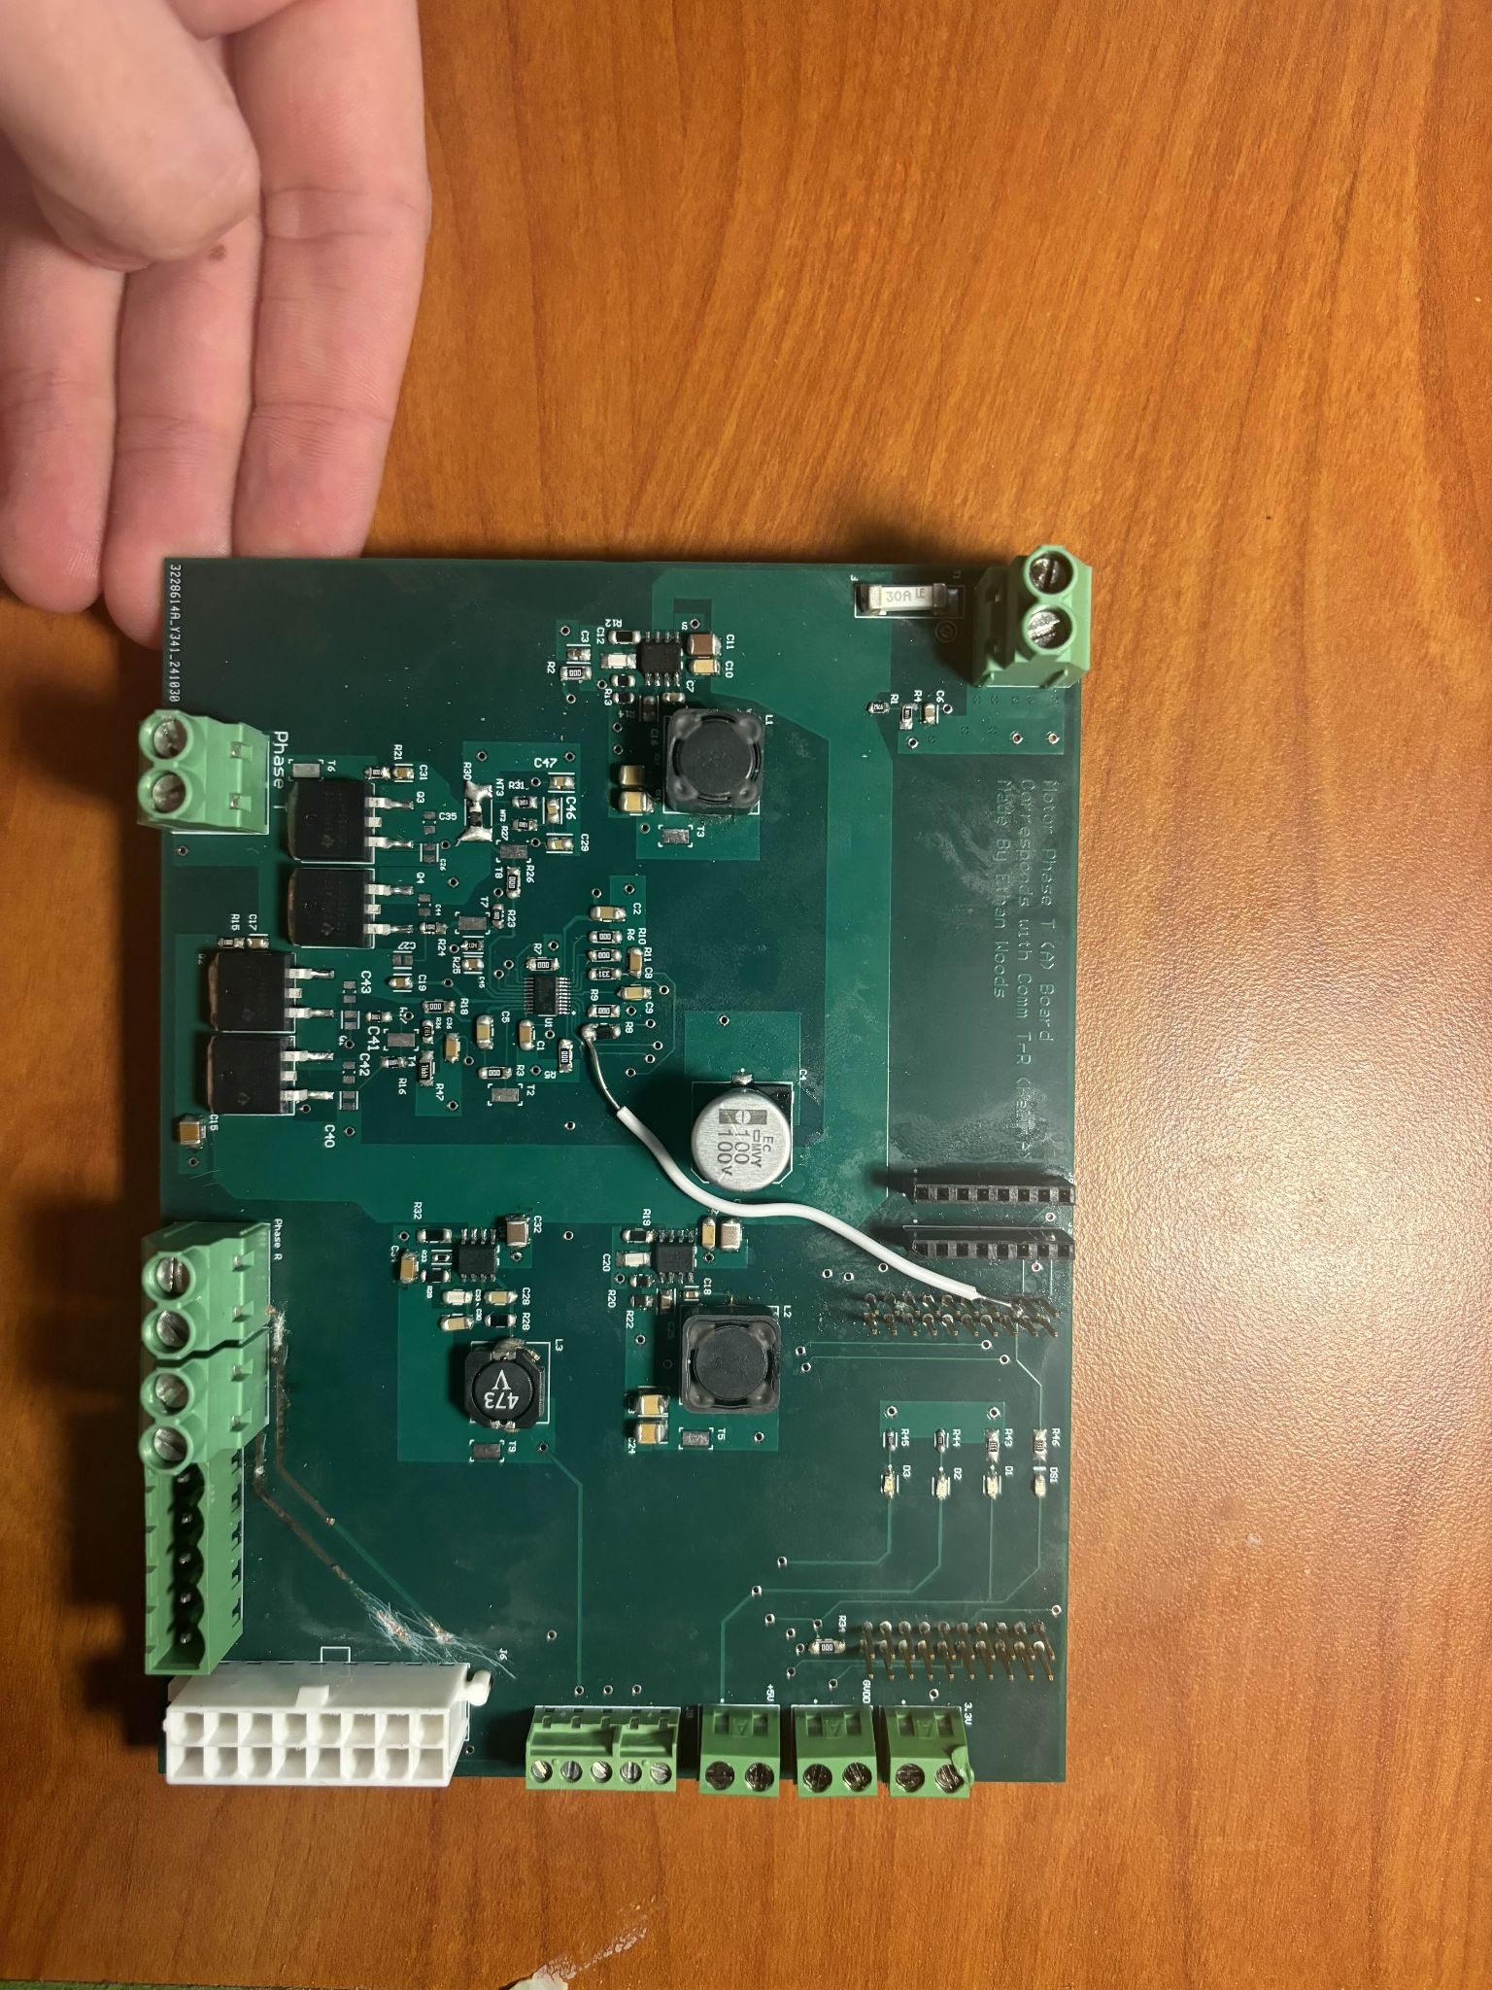
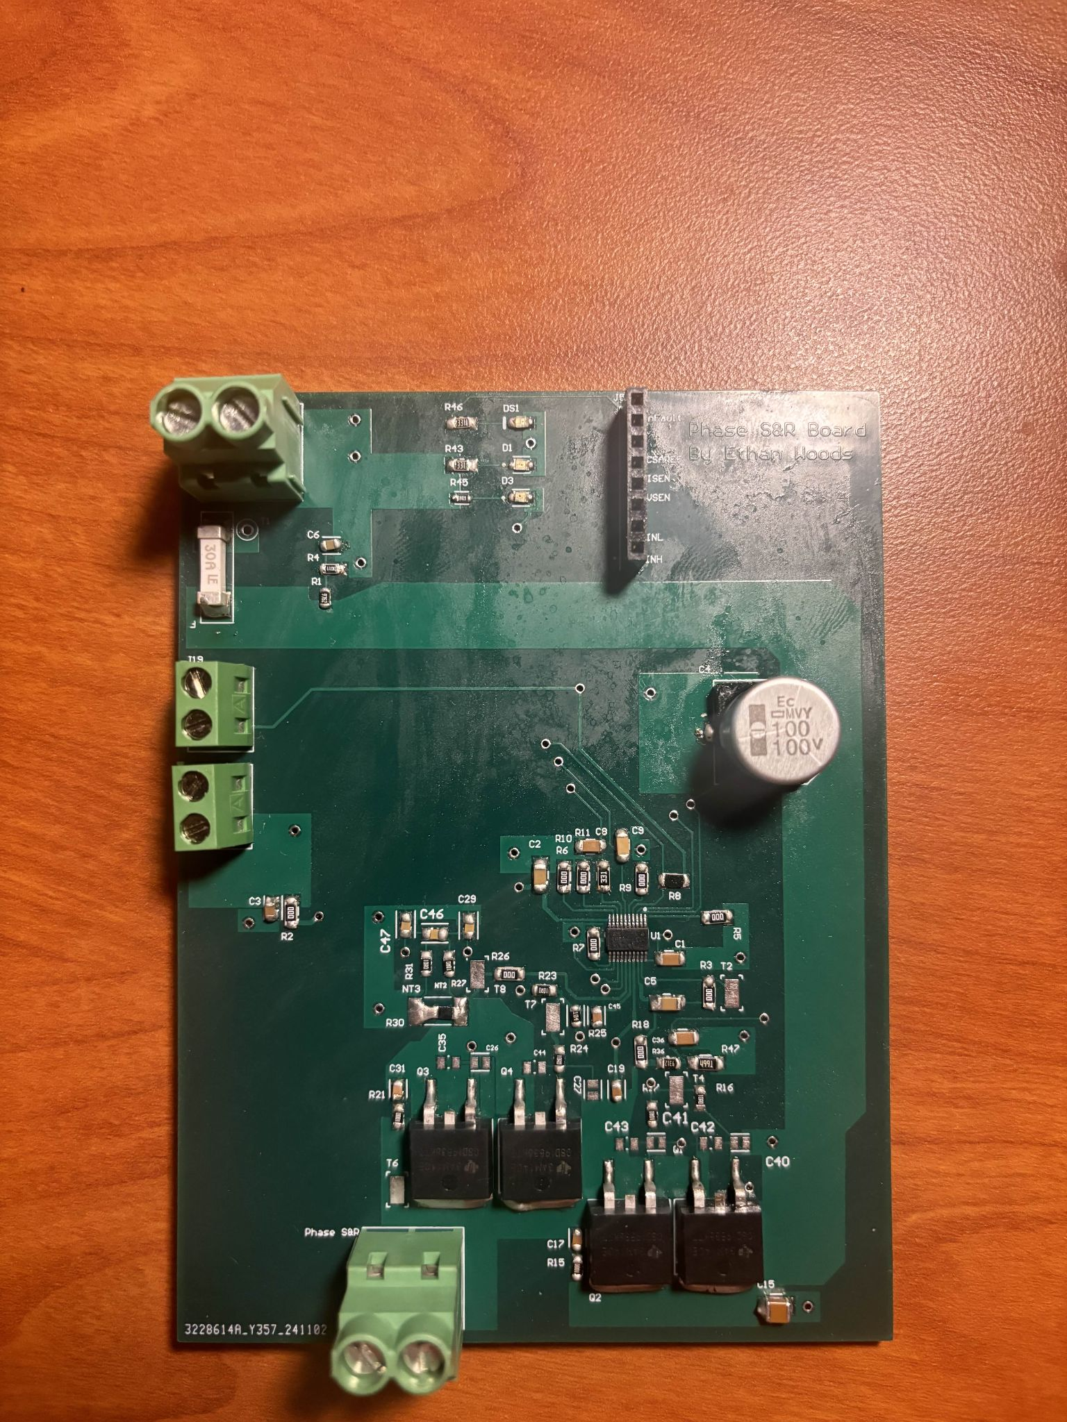
Motor/Motor Driver Subsystem
Ethan Woods
Board A
Board B&C
Final Board (Combined):
3 Motor Driver Circuits
3.3V, 5V, 12V Converter Inputs
48V Main Input
Motor Connections
MCU Connections
Note: Had to redo my original Board C due to a untraceable short. Wasn't sure if it was the chip or a short somewhere in the circuit. After making the new board, the motor worked as expected. The final board this semester will be a single board, with all functions from Boards A, B, and C combined.

Slide 10
MCU/Processing Subsystem
Adrian Guzman
Accomplishments since 403 20 hrs of effort | Ongoing progress/problems and plans until the next presentation
Compiled different programs on MCU and reviewed output on oscilloscope Wrote code that will increase/decrease PWM duty cycle based on ESP-32 input Created new schematic & layout for PCB to be used in ECEN 404 | Place order for PCB Place order for components Solder PCB after material arrival Debug new PCB, ensure previous software is running on new board to begin integration with motor driver subsystem
Notes:
Required: What has been accomplished (not just started) – is it back up and running from 403? | What are you going to accomplish in the next 2 weeks | -- “Started, began, initiated…” are not accomplishments
--You do not need to have any accomplishment on some updates if you describe in “Ongoing” what work you have been doing
-- Make things here specific and measurable/verifiable

Slide 11
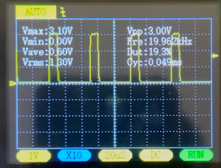
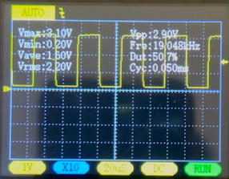
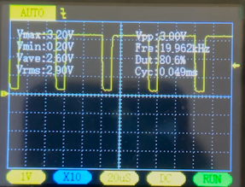
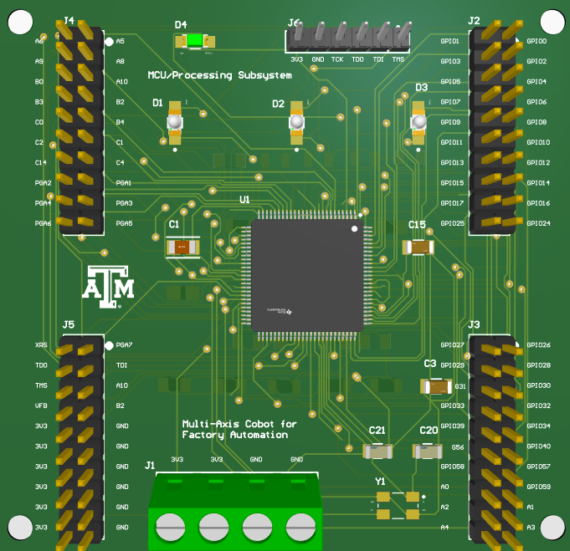
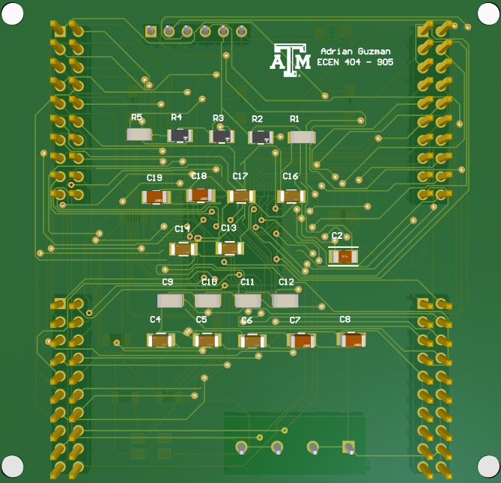
MCU/Processing Subsystem
Adrian Guzman
Duty Cycle Change
Previously in 403, the PWM signal was a stagnant square wave.
Given ESP-32 input (high/low) the duty cycle of PWM toggles from 20% to 50% and 50% to 80%.
Additionally, another program allows the PWM wave to increase from 0% to 90% continuously in one cycle
20%
50%
80%
NEW PCB Design
Created new schematic and layout for PCB
Ensured compatibility between team members
DRC showing zero errors
Review components not used from previous design to save money
Order PCB and new components by this week
Front
Back
Notes:
Required: Interesting figure related to your subsystem progress. Detail on what works, what doesn’t, what is changing.

Slide 12
Power/Battery Management Subsystem
Emily Hamsa
Accomplishments since 403 10 hrs of effort | Ongoing progress/problems and plans until the next presentation
Updated PCB layout to include more power plains Updated 12V step-down circuit to include IC more suited for this application Outlined changes needed for PCB to incorporate new design | Implement all needed changes to PCB in preparation for implementation Order and begin PCB assembly Begin work on physical design and modifications Get red-badge certification

Slide 13
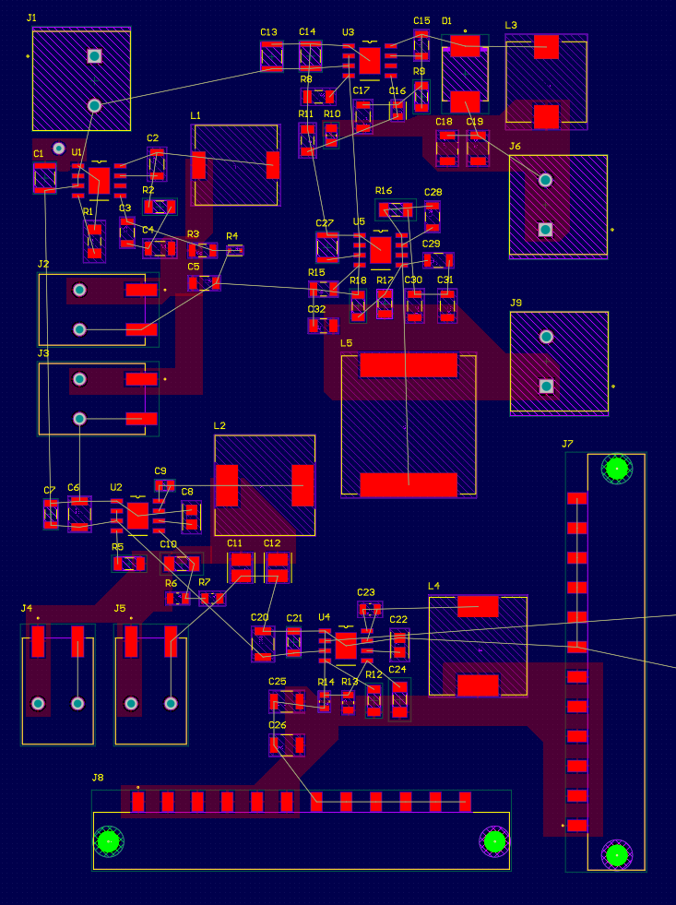
Power/Battery Management Subsystem
Emily Hamsa
End of 403:
Working: 6V 1A, 12V 1A, 24V 1A output
Not Working: 3.3V 500mA, 5V 1A output
Interesting figure related to your subsystem progress
Detail on what works, what doesn’t, what is changing
Expected Changes in 404
Load-list revision, output voltage, and PCB design changes
With removal of most BLDC motors in exchange for Servo motors, load demands will also change
Removal of the battery charger from the subsystem tasks
Efforts should be focused on implementation and physical design
Charger isn’t pertinent to the success of the project
Current progress on new PCB

Slide 14
UI/Wireless Connectivity Subsystem
Jaishil Shah
Accomplishments since 403 10 hrs of effort | Ongoing progress/problems and plans until the next presentation
- Established proper ESP-32 functionality for integration - Brainstormed and planned out the physical design of the cobot | - Finalize and confirm ESP-32 functionality - Revamp mobile application per the req. of integration - Creating and tinkering with the physical design - Accomplish wireless communication with the MCU & motors - Red-Badge Certification

Slide 15
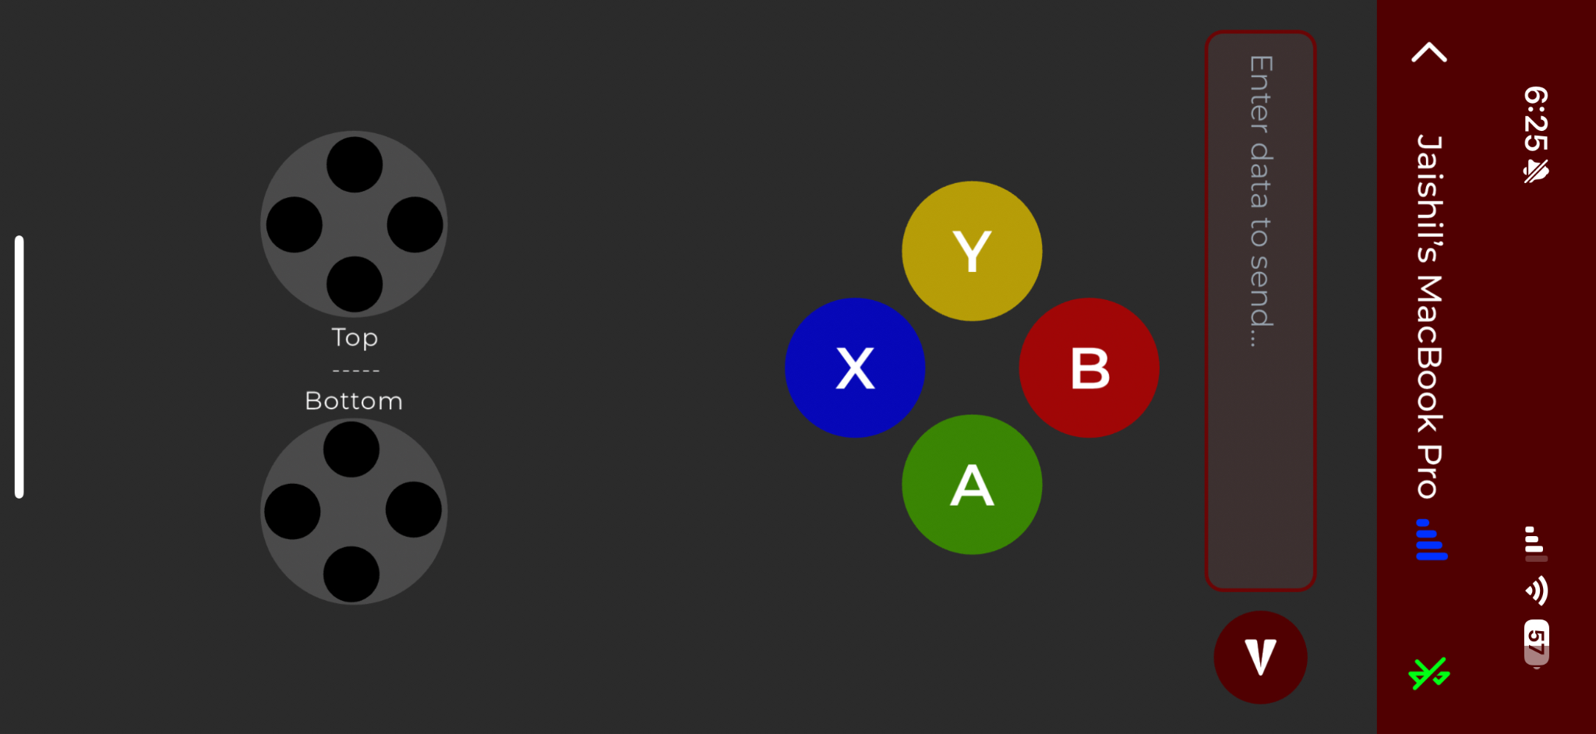
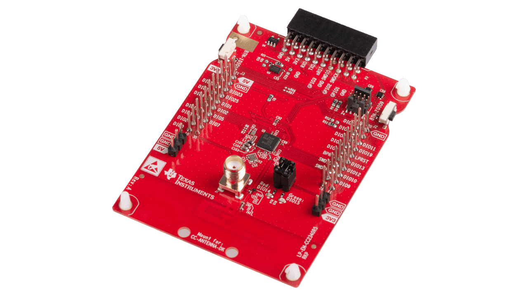
UI/Wireless Connectivity Subsystem
Jaishil Shah
- PCB design for the ESP-32 and application from 403 are being reused, with additions and complexity added.
- Spearheading the physical design and implementation of the cobot.
- Work on communication between MCU & Motors/Drivers
Issues from 403: - Buggy ESP-32 board, interest in shifting focus to TI BLE device
- Pre-purchased board allows full focus on physical design

Slide 16
Parts Ordering Status
Motor Driver Subsystem:
No parts ordered yet but the Final Design of PCB is underway. Parts are expected to be ordered by the beginning of next week and hopefully received by end of week. I plan to have the board soldered by the middle of the 3rd week.
MCU Subsystem:
No parts ordered yet, PCB and components will be ordered by Friday (1/17). Awaiting response from TI and capstone department on how to proceed with funding. Plan to receive board mid- late 2nd week and finish assembly a few days after pending its arrival.
Power Subsystem:
No parts ordered yet, but on track to finish design and order by Friday (1/17). Awaiting response from TI and ECEN department to secure funding. After expected arrival, week of 1/27, assembly will be completed promptly.
UI/Wireless Connectivity Subsystem & Physical Design:
Robotic Arm frame from Amazon that will be the skeleton of the cobot. Our team will install all the electrical components present in the final design and buy the mechanical components as they do not fall within the scope of our project’s technical requirements.
Notes:
Michelle

Slide 17
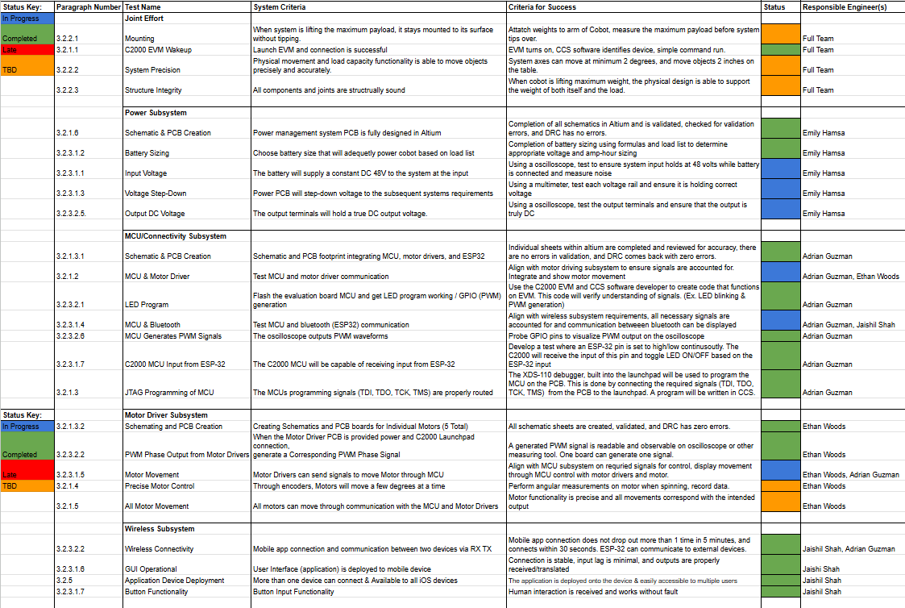
Validation Plan ECEN 404
Notes:
Required:
Execution plan
Your team planned milestones for completion of any remaining subsystem functionality, integration of specific subsystems, test, and validation plans should be presented.
Milestones should have owners … things like final integration can be group owned
Gantt chart – should indicate some 404 progress.
Try to complete all subsystem function in next 3 weeks.
Try to complete all integration 2 weeks before demo to allow for system validation and documentation

Slide 18
Thank You!

Slide 19
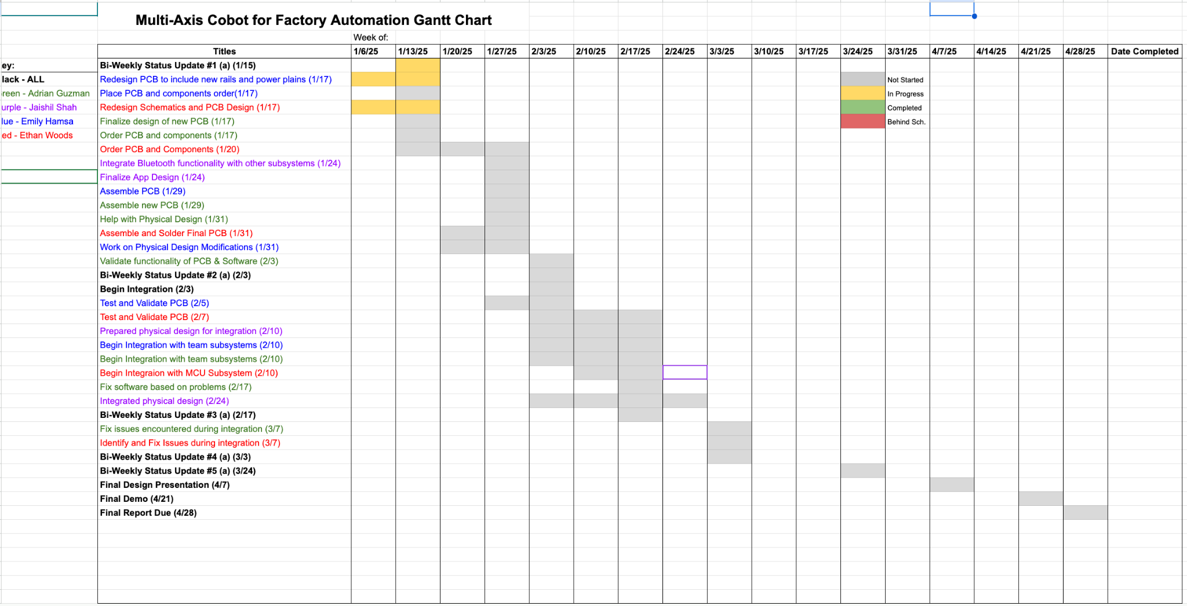
Execution Plan ECEN 404

